Slide 1
Attendify

Slide 2
Problem Statement:
Manual attendance systems are
inefficient
prone to errors
consume valuable time
In classrooms and meetings. Automating this process would increase efficiency and accuracy.

Slide 3

Attendify
It is an automated attendance system that utilizes facial recognition to capture and record attendance in real-time. This reduces the need for manual effort, ensuring a faster and more accurate process for both in-person and virtual environments

Slide 4
Key Features
Real-Time Facial Recognition
Database Management
User Authentication
Automated Attendance Logs
Captures and identifies faces as participants enter the classroom.
Records attendance automatically and saves it in CSV/Excel format.
Stores facial data and attendance records securely, with easy data updates.
Limits access to attendance data to authorized personnel only.

Slide 5
Solution Approach
Recognize faces as participants enter using machine learning algorithms.
Export attendance data into CSV/Excel formats for easy tracking.
Capture Facial Data
Real Time Facial Recognition
Data Storage
Reporting
Use a webcam to register student faces.
Store attendance records with timestamps in an SQLite database.

Slide 6
Implementation Process
01
02
03
04
Build the facial recognition system using OpenCV/dlib for detection and recognition
Create an excel database to store student details and attendance logs
Develop a user-friendly GUI for data input and management
Real-time attendance logging using the webcam feed and data processing.

Slide 7
Individual Contribution

Slide 8
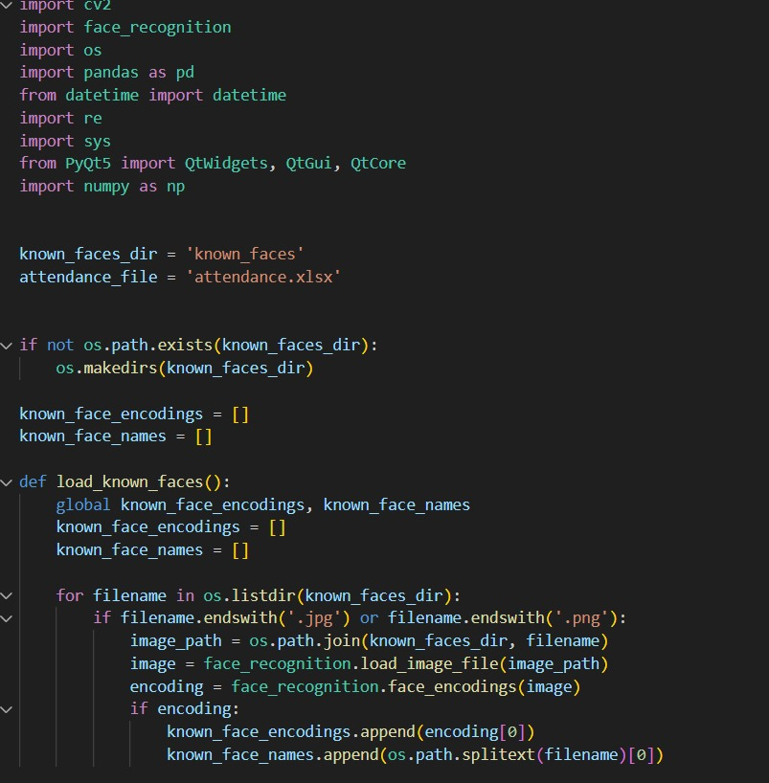
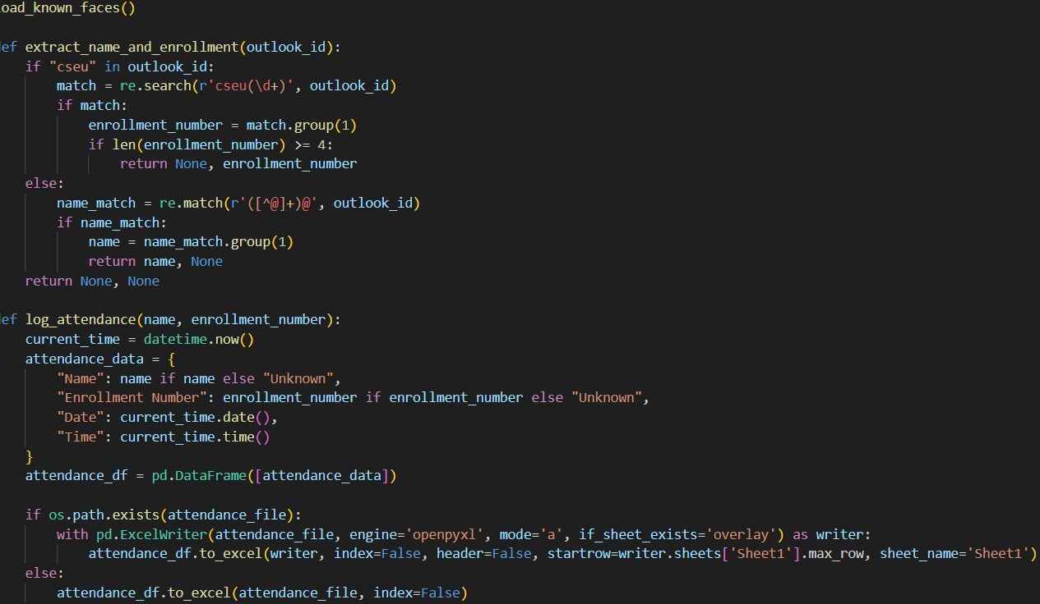
Nishant & Anuj

Slide 9
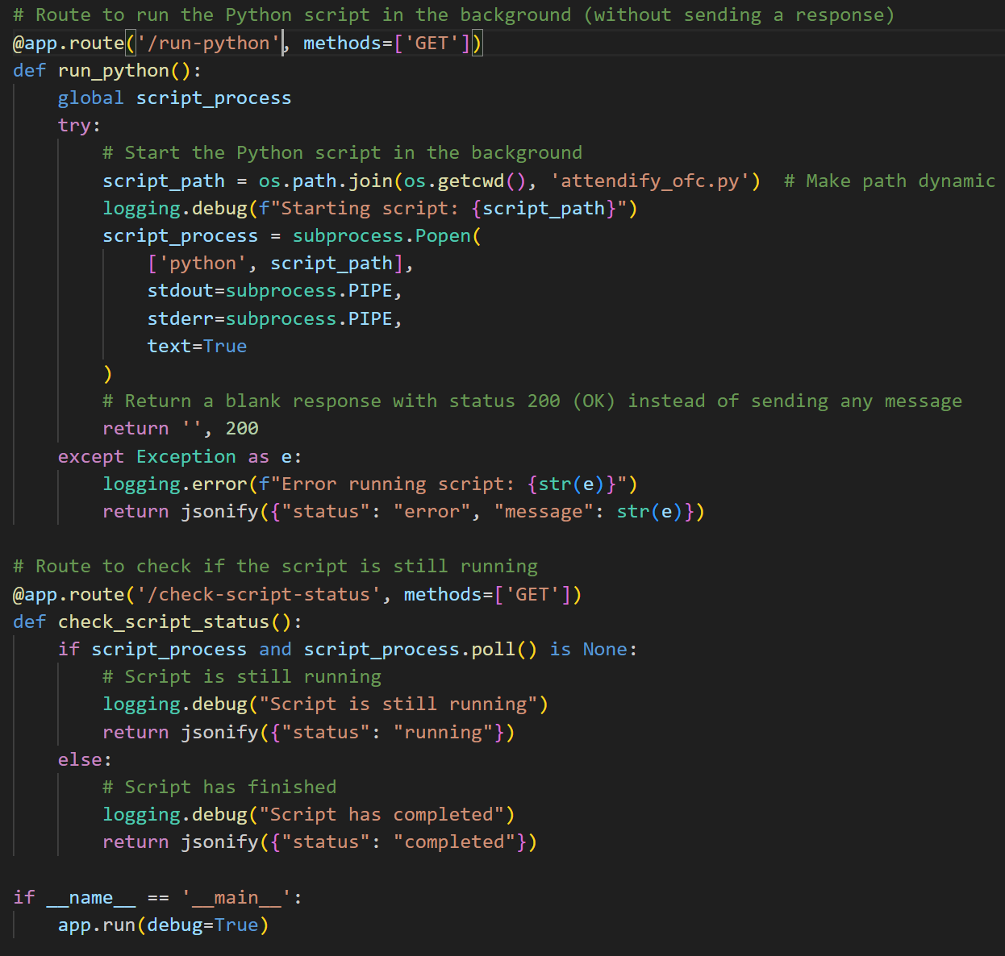
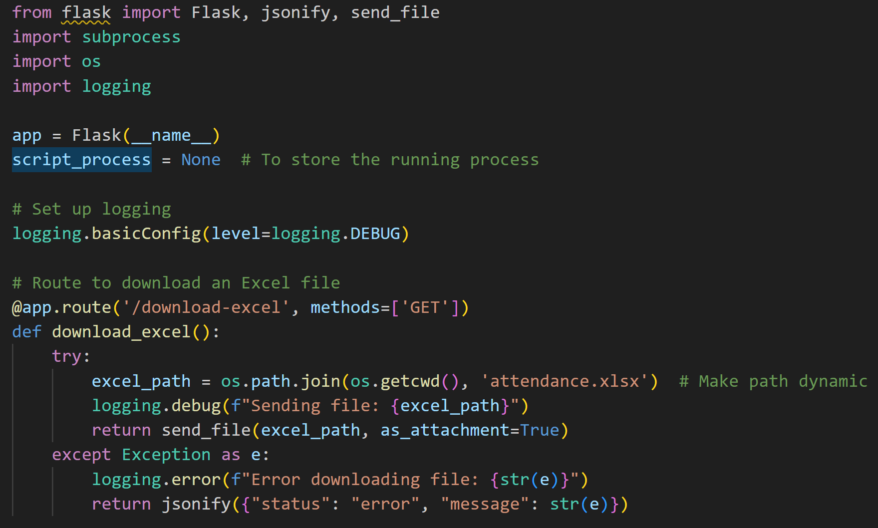
Umesh

Slide 10
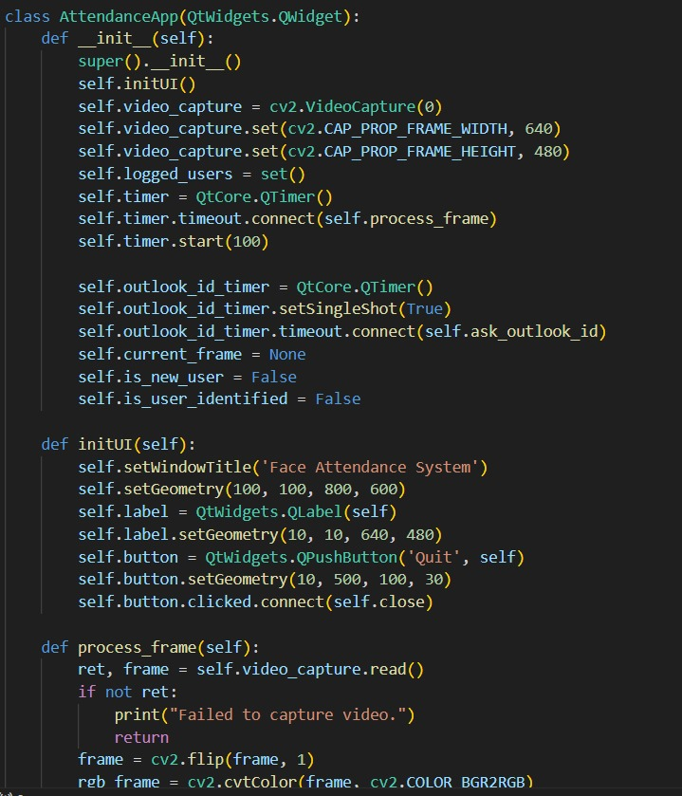
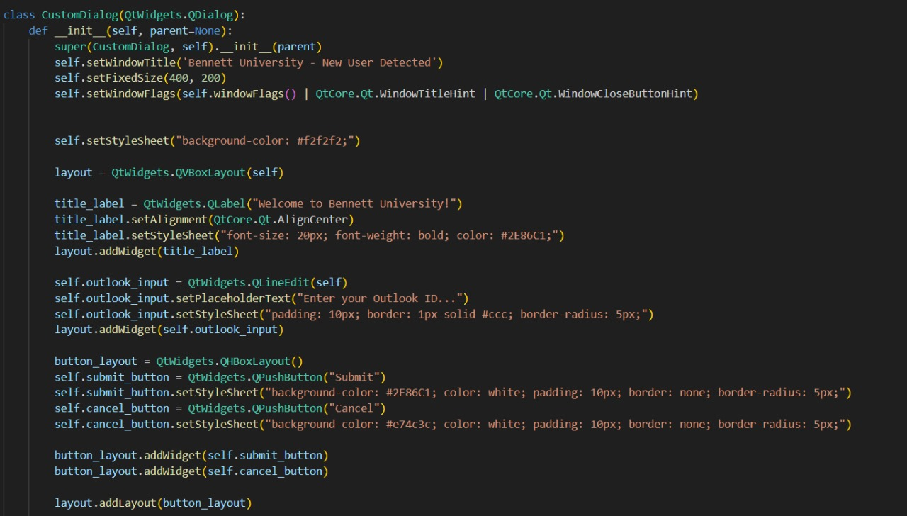
Chirag

Slide 11
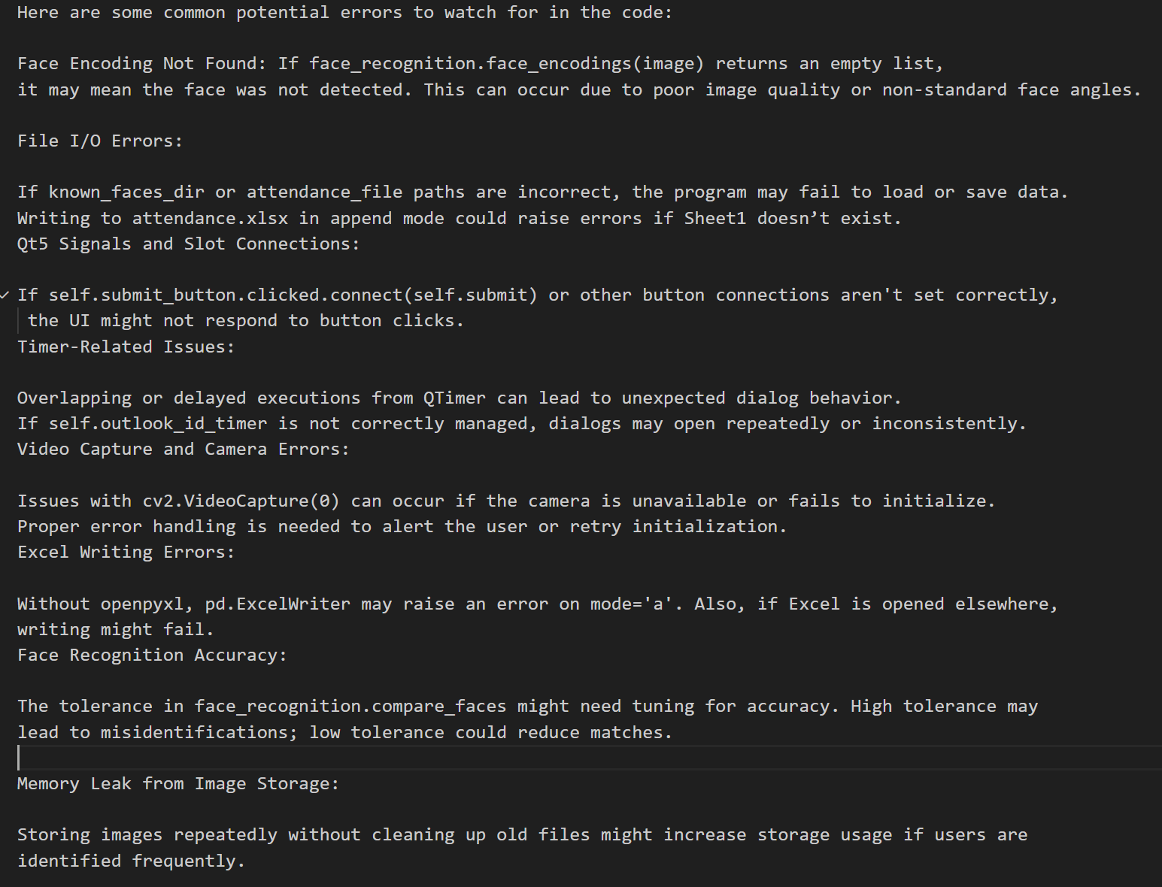
Krishnav

Slide 12
Applications
Classroom Attendance
Online/Hybrid Classes
Corporate Meetings
Efficiently tracks student attendance in educational institutions, reducing the time spent on manual record-keeping
Facilitates easy tracking of meeting attendance in offices without disrupting the workflow
Suitable for virtual classrooms, automating attendance in an online setting.

Slide 13
Applications
Remote Work Monitoring
Event Management
Useful for managing large conferences, seminars, and events by automating participant tracking.
Applicable in remote working environments to monitor employee attendance efficiently

Slide 14
Resource's Used
Programming Language: Python
Libraries: OpenCV, dlib (for facial recognition),
Interface: pyQT5 for user interaction
Data Output: CSV/Excel files for attendance logs

Slide 15
Hackadmics
Anuj
Umesh
Chirag
Nishant
Lead Developer, webpage
Debugging, Testing & Report,
GUI Development & webdev
Krishnav
Lead Developer
Debugging, Testing & Report

Slide 16
Thanks!
Do you have any questions?
Contact us:
umeshbennett1@gmail.com

